Slide 1


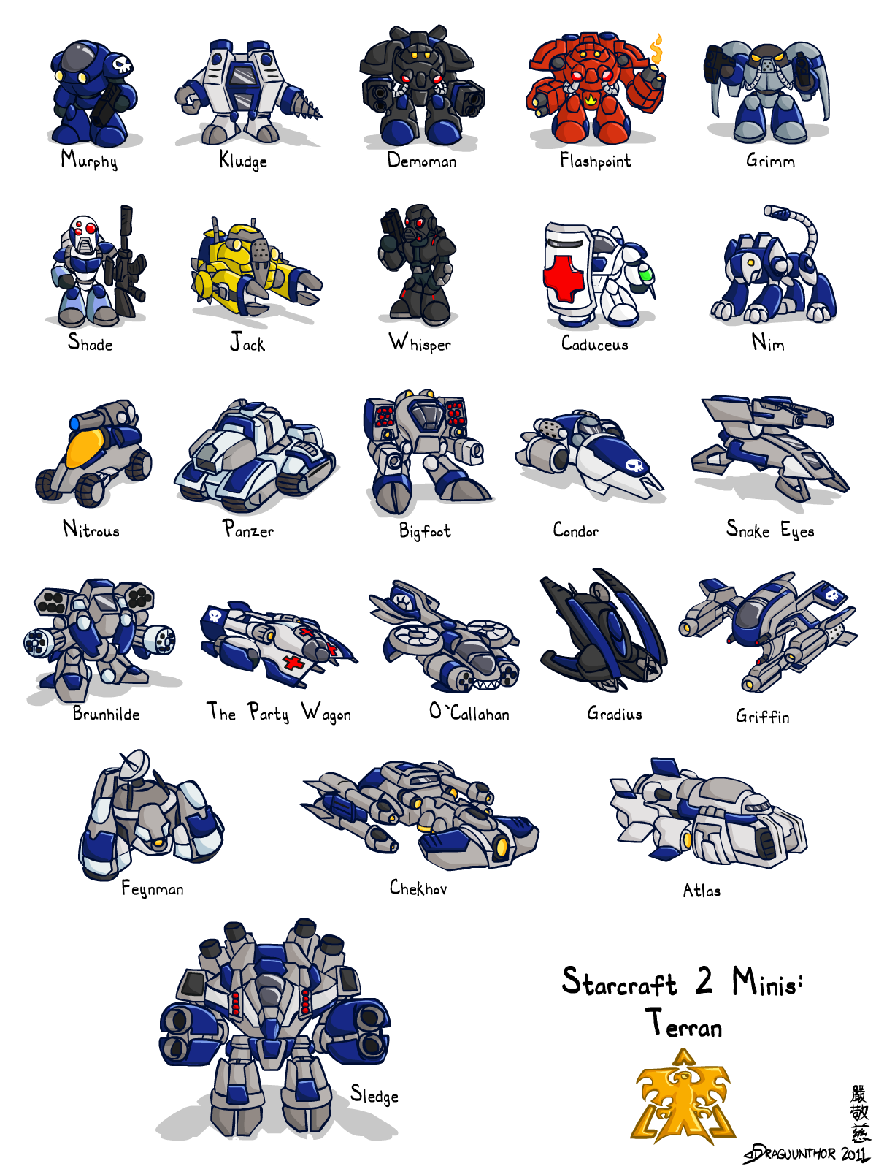
A Model-Based Method for Solving an MDP Scenario in StarCraft II
By Gengyu Zhang & Jingyi Li

Slide 2
Outline
Recap of the scenario
Results/Evaluation
Single map
Random maps
Further development
Deviation

Slide 3
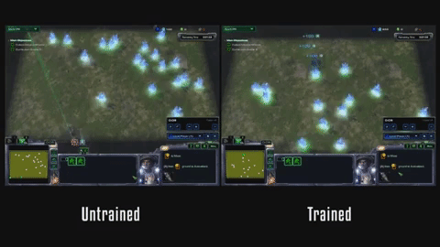

Recap of the Scenario

Slide 4
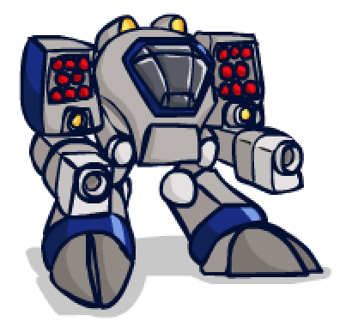

Single-Agent or Multi-Agent?
Definition of “agent”
- The 2 units
- The player who controls this 2 units
The subject who executes actions is the player rather than units.
- e.g. select point/select army
The 2 units cannot do actions both independently and simultaneously.
Conclusion: Single-agent system

Slide 5
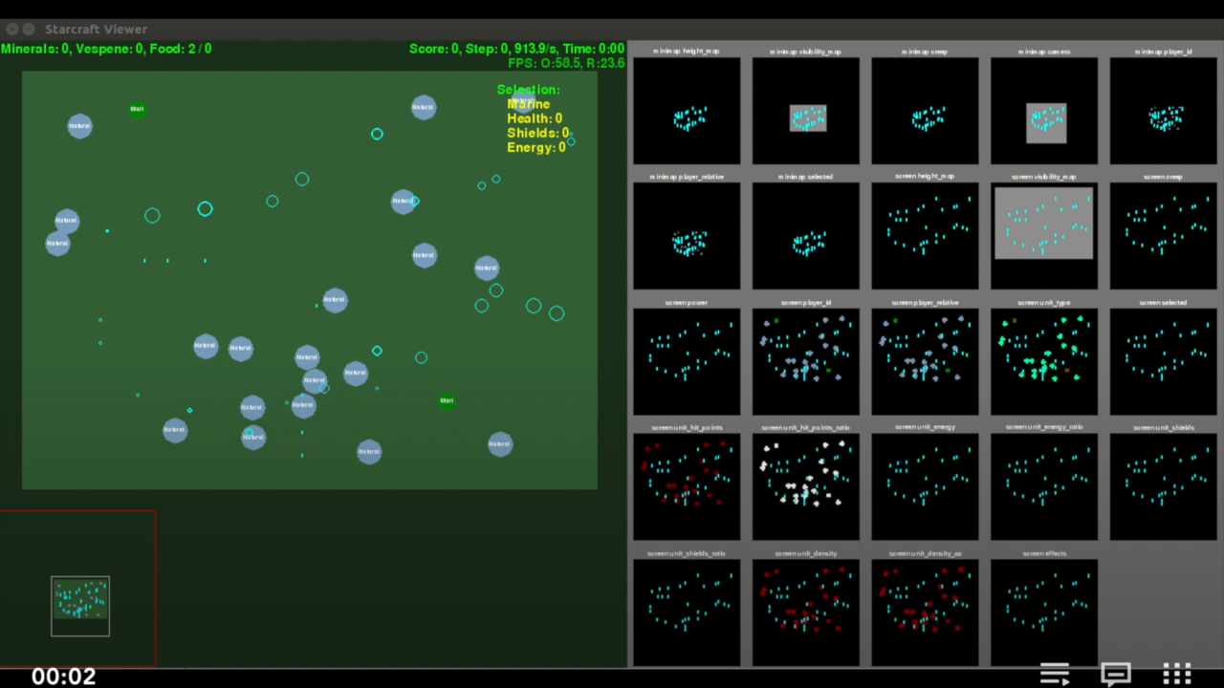
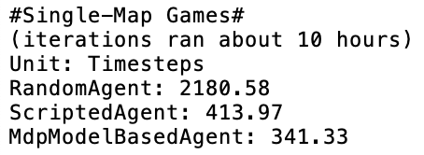
Result/Evaluation - Single Map
Results:
Timesteps needed to complete the certain map:
MDP < Script << Random

Slide 6
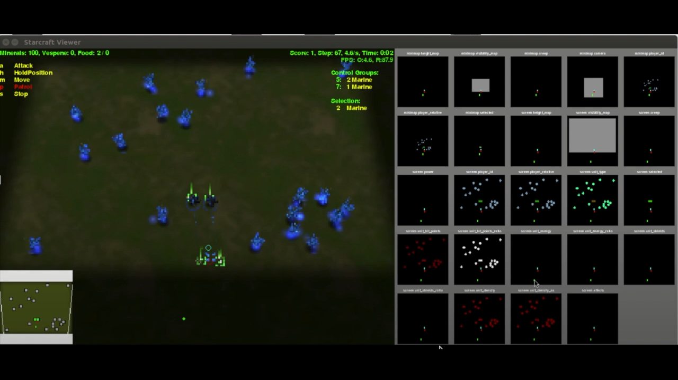
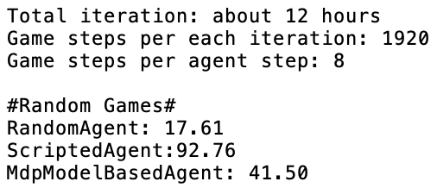
Result/Evaluation – Random Map
Results:
Minerals collected during one iteration:
Script > MDP > Random

Slide 7




Further Development
Improve MDP model performance on Random-maps
Limitations:
storage space
Possible Solutions:
Mini map
Reduce action space

Slide 8
Deviation from Proposal
Off-line to On-line
The off-line method needs combination of all states and available actions
The on-line method updates value, policy, etc. while sampling
Repeated Single Games vs Random Games
It would take a long time to reach convergence in random game
Repeated single games were more affordable

